Slide 1
SEMINAR PROJECT MANAGENMENT TOPIC: RISK MANAGEMENT
Instructors: Nguyễn Thanh Phước
Implementation members:
Nguyễn Văn Dũ – 16130332
Hồ Thanh Hiệp – 16130373
Trịnh Mạnh Hoàng – 16130392

Slide 2
MAIN CONTENTS
Risk Management Planning
Risk Management Process
Qualitative Risk Analysis
Quantitative Risk Analysis
Risk Response Planning
Risk Monitoring and Control

Slide 3
What is risk/risk management?
Any time there’s anything that might occur on your project and change the outcome of a project activity, we call that a risk. A risk can be an event (like a fire), or it can be a condition (like an important part being unavailable). Either way, it’s something that may or may not happen…but if it does, you will be forced to change the way you and your team work on the project.
Risk Management is the process of identifying, analyzing and responding to risk factors throughout the life of a project and in the best interests of its objectives. Proper risk management implies control of possible future events and is proactive rather than reactive.

Slide 4
Why need risk management?
The purpose of risk management is to:
Identify possible risks.
Reduce or allocate risks.
Provide a rational basis for better decision making in regards to all risks.
Assessing and managing risks is the best weapon you have against project catastrophes. By evaluating your plan for potential problems and developing strategies to address them, you’ll improve your chances of a successful, if not perfect, project.

Slide 5
Why do risk management?
Additionally, continuous risk management will:
Ensure that high priority risks are aggressively managed and that all risks are cost-effectively managed throughout the project.
Provide management at all levels with the information required to make informed decisions on issues critical to project success.

Slide 6
How to do risk management?

Slide 7
Risk Management Planning
What’s risk management planning
As stated above, risks are any events or conditions that affect the plan that affects the outcome of the project set out earlier, so what is the plan to manage risk, is the process by which We devise a risk management plan to approach risks scientifically and systematically to identify, control, prevent and minimize losses and loss of adverse effects of risks.

Slide 8
Risk Management Planning
Why we need to risk management planning
There is no guarantee that your project will go smoothly with the plan you have set, any small fluctuations can occur in your project and it will also affect a somehow comes to the project plan and changes the results, schedule, plan of the project. And we call it risk.
By the time the risk actually occurred to your project, it was too late to do anything about it. That's why you need to plan for risk in the first place and keep coming back for more planning throughout the project.
The risk management plan tells you how you will handle risks in your project. This document records how you assess the risk, who is responsible for the implementation, and how often you conduct risk planning.

Slide 9
Risk Management Planning
How to deal with risk.
When you plan your project, the risks are still uncertain. But in the end, some of the risks you plan to take place, and that's when you need to deal with them. And here we have four basic ways to handle risk
Avoid
Is trying to avoid, eliminate or minimize the likelihood of risk (it's like you will limit or not go out at 12 pm to avoid being killed)
Mitigate
As a measure to minimize the possible damage (this method is like you wear a helmet when driving to minimize the possibility of an accident and injure you)

Slide 10
Risk Management Planning
Transfer
Risk transfer is the most ideal model, from rudimentary risk transfer to insurance participation. This is the most effective and effective tool to deal with losses. (For example, instead of transporting a truck of smuggled cigarettes to the male, you divide the cigarette into smaller chunks and transport it to each different vehicle in case the police get caught. whole car cigarette)
Accept
This is the form by which the victim accepts that loss and usually, there are two ways to accept the risk, which is to be proactive and passive.
Passive acceptance is the absence of preparation for risk to find a solution and compensate.
Proactive acceptance is the establishment of a resource reserve fund to compensate for the risks occurring. And often resources will not be used optimally, even very passively because the level of losses is not completely the same and unpredictable.

Slide 11
Risk Management Process
What’s it?
Project risk management is a process that includes risk assessment and mitigation strategies for those risks. Risk assessment includes both identifying potential risks and assessing the potential impacts of risks. A risk mitigation plan is designed to eliminate or minimize the impact of risk events that occur when they occur that negatively affect the project. Identifying risk is a creative and disciplined process. The creative process consists of brainstorming sessions in which the team is required to create a list of everything that can go wrong. All ideas are welcome at this stage with the evaluation of ideas coming later.

Slide 12
Risk Management Process
Risk Identification
A more disciplined process consists of using the checklist of potential risks and assessing the likelihood that such events may occur within the project. A number of companies and industries have developed a risk checklist based on experience from past projects. These checklists can be helpful for project managers and project teams in identifying both specific risks in checklists and extending team thinking. Past experience of the project team, project experience in the company and industry experts can be a valuable resource to identify potential risks to a project.
Identifying sources of risk according to the portfolio is another method to explore potential risks on a project. Some examples of categories for potential risks include:

Slide 13
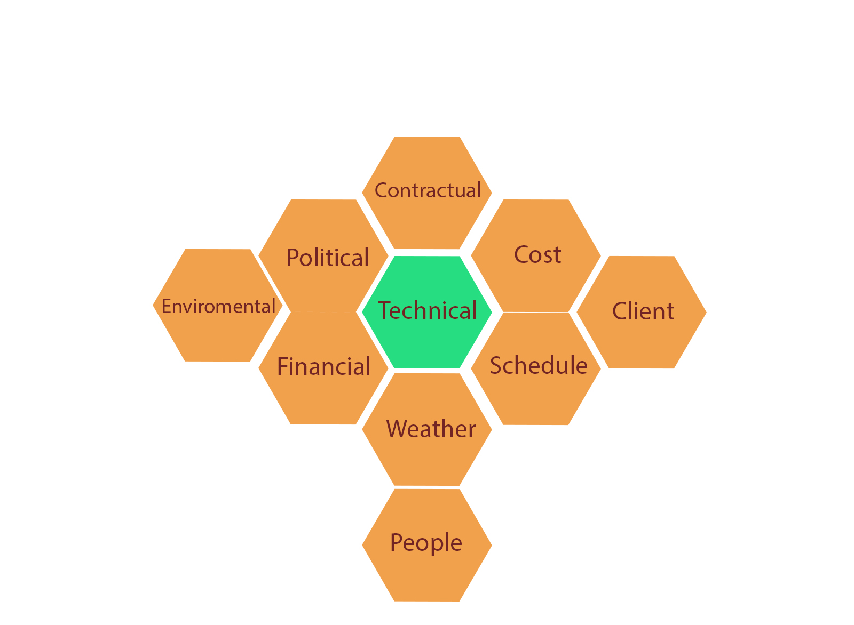
Risk Management Process

Slide 14
Risk Management Process
In fact, depending on the business, the company, there will be different frameworks to divide the work and develop risks.
Here we will describe a framework to divide and develop risks which are WBS (work breakdown structure).
This framework divides the work and risk structure into a table with 2 columns (1 column is the task and 1 column is the possible risk at that task).

Slide 15
Risk Management Process
Task | Risk
Contact Dion and Carlita | Dion backs out Carlita backs out No common date available
Host planning lunch | Restaurant full or closed Wring choice of ethnic food Dion or Carlita have special food allergies or preferences
Develop and distribute schedule | Printer out of toner Out of paper

Slide 16
Risk Management Process
This approach helps the project team identify known risks, but can be limited and less creative in identifying unknown risks and risks not easily found in WBS.

Slide 17
Risk Management Process
Risk Evaluation
After identifying the potential risks, the project team will evaluate each risk based on the probability of the event of the risk and the potential loss associated with it. Not all risks are the same. Some risk events are more likely to occur than others and risk costs can vary greatly. Assessing the risk of the probability of occurrence and the severity or potential loss to the project is the next step in the risk management process.
Having criteria to identify high impact risks can help narrow the focus to a few important risks that need to be minimized. For example, suppose that high-impact risks are those that can increase project costs by 5% of the concept budget or 2% of the detailed budget. Only a few potential risk events meet these criteria. Here are a few important potential risk events that the project management team should focus on when developing a project or management risk mitigation plan. The risk assessment is about developing an understanding of what is potentially the most likely to occur and can have the greatest negative impact on the project.

Slide 18
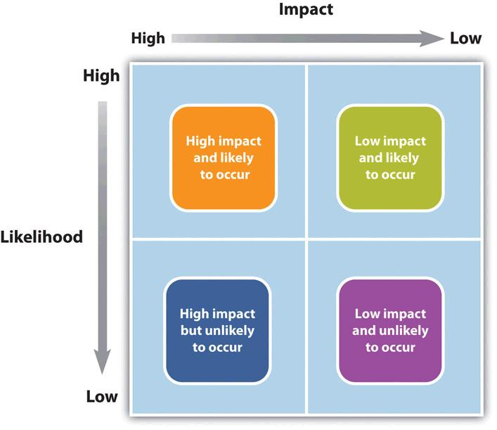
Risk Management Process

Slide 19
Risk Management Process
Risk Mitigation
After identifying and assessing risks, the project team developed a risk mitigation plan, which is intended to reduce the impact of an unexpected event. Project teams minimize risks in several different ways:
Avoid
Mitigate
Transfer
Accept

Slide 20
Risk Management Process
Contingency Plan
Project teams often develop an alternative method to accomplish a project goal when a risk event has been identified that can discourage the achievement of that goal. These plans are called contingency plans.
Example: The risk of a strike truck driver can be mitigated by a contingency plan using a train to transport the equipment needed for the project. If a critical part of the device is late, the impact on the schedule can be minimized by changing the schedule to accommodate late device delivery.

Slide 21
Risk Management Process
Project Risk By Phases
Initiation
Project risks are handled in different ways depending on the stage of the project.
Start:
Risks related to the unknown. Many things are unknown at the start of the project, but the risks must be considered in the inception phase and weighed against the potential benefits of the project's success to decide whether or not to choose the project.

Slide 22
Risk Management Process
Project Risk By Phases
Planning phases
Once the project is approved and it moves into the planning stage, risks are identified for each major activity group. A risk division structure (RBS) can be used to determine the level of detailed risk analysis.
Implementation phases
As the project progresses and more information is available to the project team, the overall risk on the project often decreases, because the activities are carried out without loss. The risk plan should be updated with new information and check the risks associated with the activities performed.
Closeout Phases
In the closing phase, risk sharing and risk transfer arrangements should be signed and the risk-sharing structure checked to ensure that all risk events have been avoided or minimized. Final estimates of risk losses can be made and recorded as part of the project document.

